Slide 1

POL 2012: Theories and Models in Political Economy
Financial crisis
Espen Moe
Department of Sociology and Political Science
espen.moe@ntnu.no, #9587, 73592230

Slide 2
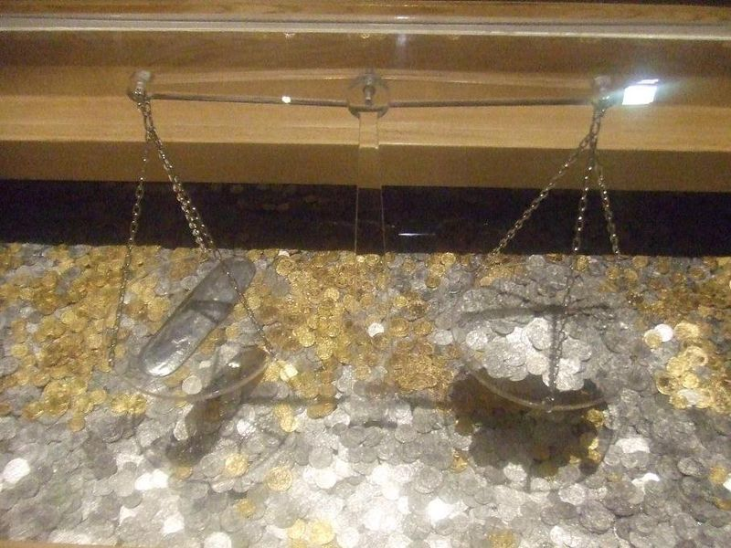
Monetary systems
Important why?
Short answer:
System through which international transactions can flourish
Makes trade easier and more predictable
To avoid financial crises…
Story of the value of money
Trying to fix money to something permanent
Story of the history of international transactions
Create something fixed in a world of flux
DIFFICULT!

Slide 3
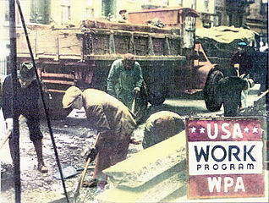
Financial crises
Not a new problem!
And they re-occur time and again
1720s: South Sea Bubble?
1790s: Canal mania
1840s: Railway mania
1890: Baring crisis
1929: Great Depression
1997-98: Asian financial crisis
2001: Dot.com bubble
2007-?:

Slide 4
Cycles in the world economy
Schumpeterians: Financial crises linked to long economic waves. (Empirically 50-60 years.)
Marxists: Capitalism creates financial crises
Keynesians: Financial crisis when we don’t regulate capitalism
Carlota Perez argument (Schumpeterian)
Financial crises when financial capital runs ahead of production capital.
Overinvesting based on initial hype
Failure to fulfill on early promises
Crash
From de-link to re-link. Growth picking up again – but at a reasonable and sustainable pace…

Slide 5
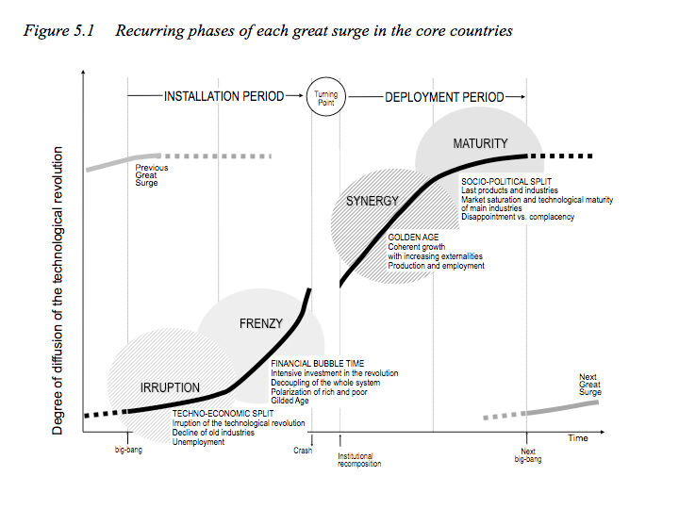
Financial bubbles

Slide 6
Financial crises
Since Bretton Woods
Different mixes of fixed and floating
1980s: Debt crisis in Latin America
1994: Mexico
1997-98: Asian financial crisis
2001-02: dot.com, Brazil, Russia
2007→ ?: Present financial crisis

Slide 7
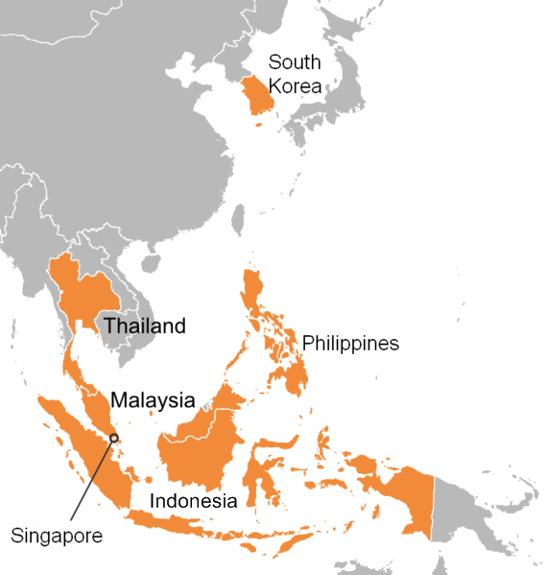
Asian financial crisis; backdrop
1980s→-90s policy environment changed
Farewell to Keynes
Price stability over unemployment
Independent central banks
Neoclassical economic theories
Deregulation, liberalization
Dismantling of capital controls
Asian economies strong growth
Huge inflow of foreign money
Sky is the limit? Tiger economies!

Slide 8
Asian crisis; potential problems?
Banking systems still underdeveloped
Borrow money more cheaply abroad
Foreign loans
What if there is a devaluation…?
Quasi-contractual relationships between political and economic elites
Moral hazard
Dollar peg
Dollar appreciates → local currencies appreciate

Slide 9
Asian crisis; what happened?
Moral hazard → bad loans
Real estate bubble
Insolvent banks and financial institutions
Dollar peg
Appreciating dollar → overvalued local currencies
Massive outflows of capital
Foreign exchange reserves drained
From fixed to float, depreciations

Slide 10
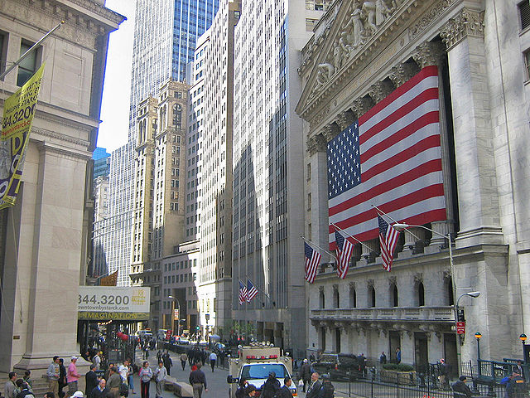
Current financial crisis
Lesson from Asian financial crisis
Need larger stocks of foreign reserves
Run current account surpluses!
Keep undervalued currency
Invest current account surplus in US debt!
Backdrop to the current crisis
Asian surpluses invested in US debt
US money supply up
US interest rates down
Cheap credit
Housing bubble

Slide 11
Current crisis
US lessons from Asian crisis
Laissez-faire better than close relationships
Lax on regulation, govt staying out of the financial sector
US complacency after years of growth. Not grasping why massive inflows a problem.
THEN: May 2007 first hedge funds collapsing (Bear Stearns rescued, Fannie Mae and Freddie Mac sort of rescued, AIG rescued, Lehman bankrupt)

Slide 12
Current crisis; securitization
Asset bubble, real estate bubble
Home prices up 60%, 2000-06
Subprime loans
Securitization
Mortgages bundled together and sold on to investors.
Advantages (in times of stability)
Spreading of risk. Because not everyone fail simultaneously.
Leveraging improving the efficiency of the financial sector

Slide 13
Current crisis
Disadvantages:
What is good during times of stability can lead to systemic failure during times of change!
Everyone failing simultaneously!
Bubble crashing → debt-servicing problems for institutions purchasing securities. Problems for the insurance companies insuring the institutions that had purchased securities…
Bankruptcies worse because of the highly leveraged purchases

Slide 14
Fed vs. ECB; different response
$200 billion injected into the market by the Fed, the ECB and the Bank of England
Expansionary monetary policy → low interest-rates.
But apart from that, major difference! WHY?
Keynesian policies in Europe and neoliberal in the US? NOPE!
US, $800 billion stimulus → demand
Europe, fiscal discipline → budget deficit

Slide 15
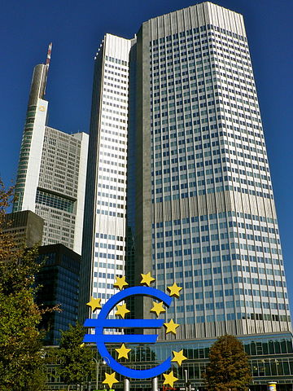
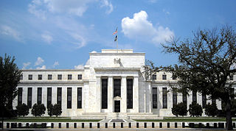
Fed vs. ECB; why?
Nothing is set in stone. Obama didn’t lose the 2012 election. But he didn’t control Congress – Fiscal Cliff? Trump?
Debt problems different in Europe and the US. International markets not allow expansionary policies in Greece
European banking system heavily exposed to European sovereign debt
Influence of Germany on the ECB → anti-inflation. Fed; deflation a bigger problem
ECB more insulated from politics than the Fed – need a treaty change
EU countries so different that hard to find a monetary policy that fits them all
Greater faith in the US reigning in fiscal stimulus than the EU

Slide 16
Who is right? Fed or ECB?
None of them…?
In many ways Fed and ECB telling different versions of the same story.
Try to tell a different story instead…?
What drives growth? In the long term? 50y++
Budget balance, trade, inflation, interest rates?
STRUCTURAL CHANGE!
(Based on innovation and technological progress)

Slide 17
Structural change
Different historical epochs have had different engines of growth.
World economy has gone through phases of growth, punctuated by major crises
Whenever financial capital has become de-linked from the production capital
Happens when financial capital cannot find things to invest in (→ real estate, paintings, gold, diamonds, exotic cars, football)

Slide 18
Financial crisis = production crisis?!
The reason why the bubble grew so big:
Western world possibly lost out on the most recent wave of growth
The financial sector as driver of growth?
ICTs.
YES: Generic. Led to major productivity improvements in many industries. GOOD!
NOPE: Also gave rise to run-amok financial sector. True, efficiency improvements. BUT CANNOT MAKE MONEY JUST FROM MAKING MONEY!
The idea that financial services can substitute for actual production must surely be dead!

Slide 19
Germany vs. Greece
Piketty: «Germany has never repaid its debts. It has no right to lecture Greece.»
Germany not repaying after WWI or WWII, but made France repay heavily after 1870. No moral high ground!
Two ways of repaying
Strict budgetary discipline over 100 years
Inflation, tax on private wealth, debt relief
Wirtschaftswunder
1945: German debt 200% of GDP. 1955: 20%.
60% of G debt cancelled + restructured
Solution: Clean slate
Krugman:
Eliminating deficits during a crisis is a recipe for depression. Delusion of austerity!
No good alternatives short of leaving the Euro
Greece a unique case. Low interest rates in all the other countries.
Ferguson:
At some stage no longer possible to provide debt relief, no longer possible to grow one’s way out
Problem: Clean slate makes no sense if the problem is structural
Not a moral argument
Is Greece over the hump? (Or will there just be ever more humps…?)
Europe going the way of Japan?
No growth, no inflation, negative interest rates

Slide 20
Stimulus vs. austerity?
Ferguson:
https://www.youtube.com/watch?v=77xI4QGMGYM
Not about stimulus vs. austerity. Missing the point! Debt → slow future growth → impossible to repay the debt. Intergenerational conflict!
Age of debt is done? Maxed out our credit cards!
Otherwise, crisis after crisis after crisis. Especially in Europe.
And: Long-term, social security will run huge deficits. Govt must be shrinked.
Every crisis takes away from our ability to do stimulus
Krugman:
Stimulus has NOT → soaring interest rates or a fiscal crisis
Keynesian medicine worked!
Slow US recovery is because of austerity in Europe.
Austerity is dead! [The Austerity Delusion] 90% debt is not critical!
Schumpeterians:
But, the stimulus only led to a very weak recovery
Something structural that is seriously wrong!

Slide 21
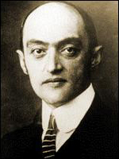
Solutions?
Keynesian medicine (fiscal stimulus)?
Only work if this is a demand problem
Not lead to structural change, just a temporary effect and bigger long-term national debt
Neoliberal medicine (austerity policies)?
Kill off the growth dynamics of the economy
Schumpeterian medicine
Spending focused on long-term opportunities
Human capital, innovation
Removal of vested interests

Slide 22

Schumpeter on future crises
«Will capitalism survive? No, I don’t think it can»
Schumpeter on the conditions for creative destruction to disappear
Socialization of the capitalist economy
But not socialism.
A capitalism Schumpeter hardly would have called capitalism.
Corporatization, bureaucratization
«Bureaucratic state collectivism»
Maintain living standards and industrial employment at all cost and in every industry
But also, silting up of rigidities in the system
Loses its dynamism, creativity, individualism

Slide 23
Is he right?
Rings true for some of the Mediterreanean countries!
Innovation and change the economic engine
Instead focus on redistribution rather than production
Huge insider-outsider problems, must be solved
But results in lower wages, higher retirement age, etc.
The left fails in keeping this sacrosanct, the right fails in thinking that this is the whole solution.
Innovation as the engine of the economy, and if the engine doesn’t re-start, then no growth…!
Politics cemented – old cleavages permanent

Slide 24
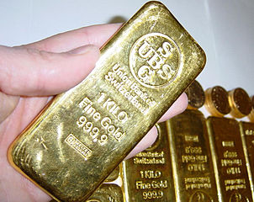
Gold standard as a solution?
Gold Standard
c1870s-1933
Exchanges rates permanently fixed to gold
Latin Monetary Union
Scandinavian Monetary Union
Bretton Woods
1944/1959-1971/1973
Goal: fixed rates but with flexibility
Special role of the dollar
Nixon

Slide 25
Scenarioes
Return to normalcy and business as usual
Decreasing rate of innovation
Old growth rates cannot be returned
Growing, unsustainable foreign debt
New growth, but not in the West – hegemony shifts to Asia
Energy problems that unsolvable
Fracking solves the energy crisis
Potential game-changer
But leads to a climate crisis instead…
Notes:
Noe om at i «gamle dager», så innovere og eksportere seg ut av problemene. Ikke like opplagt at de gamle løsningene holder!
Mangel på innovasjon? Vår tidsalder en parentes i verdenshistorien, siden ca 1820 og for de fleste land mye kortere tid. Gregory Clark. Bygd på innovasjon og teknologisk fremskritt og i en slik takt at trumper demografisk vekst.
Patentkontor, 1890-t, UK. → kan få nye innovasjoner fra steder vi knapt nok ante. Har skjedd før. Men akkurat nå ikke så mange opplagte kandidater.
3D-printing? Få IKT-revolusjonen tilbake på beina, gjøre den til produksjon heller enn bare service.
Konsekvenser:
Hvis prøver å investere oss ut, bruke masse penger, men veksten aldri vender tilbake til «normal», da sitte igjen med en utenlandsgjeld som vanskelig håndterbar. I USA i hvert fall ett politisk parti som er hysterisk rundt bruk av penger. Hvis vi tror at veksten ikke kommer tilbake, enten pga fallende innovasjonstakt eller pga høye energipriser, så ta konsekvense av det og la være å låne opp i milliardsummer. Sånn sett kanskje helt greit at Europa har gått for innstramninger. Ikke overbevist om at Europa i stand til å kutte senere. I USA i hvert fall ett parti som hysterisk opptatt av offentlige utgifter. Republikanerne kan fort ha rett! I hvert fall med tanke på hva som er den langsiktige trusselen mot økonomien.
Eller bare hegemonisk skift? Ikke lenger Vesten som står for økonomisk vekst og utvikling?
Catching-up mye enklere enn forging ahead. Ikke sikkert at kinesiske vekstrater kan opprettholdes. Ganske sikkert at de ikke kan det…! Tidligere kriser, også påfallende at ikke nødvendigvis slik at ledernasjonen før krisen også er ledernasjon etterpå. Fører ofte til systemiske skift. MEN; når dette har skjedd før, har på en måte utfordreren stått klar med spisskompetanse innenfor genuint nye områder og brukt denne. Så, i hvert fall i ettertid ikke vanskelig å se hvorfor nasjoner har avløst hverandre som industrielle og økonomiske ledere. Ikke like opplagt at Kina eller noen andre har dette. Kina baserer seg fremdeles på catch-up-type vekst. Ikke i forkant på veldig mange områder. Handler fremdeles mye om volum og lave kostnader. Og for all del, ikke dermed sagt at aldri i stand til å komme seg videre fra det. Men sier at de oppviser ikke alle av de samme egenskapene som de utfordrerne som har tatt over tidligere. Ikke opplagt at Kina kan klare forging ahead like enkelt som catching up…!
Ikke opplagt at kinesisk vekst kan fortsette for evig tid. Og forging ahead mye vanskeligere enn catch-up.
A&R ganske klare på at kinesisk vekst så langt primært er extractive. Ikke schumpeteriansk. Har handlet om å ta etter, men har ikke handlet om creative destruction. Skjønt, på energiområdet, tegn i retning av statlig initiert CD? Innfasing av vind og sol og ditto utfasing av kull og olje. Om det nå skjer.

